Slide 1
IMPLEMENTING A WEB
BROWSER TAB SYSTEM
GROUP NO: 17

Slide 2
TEAM MEMBERS-
Bhavvuk D Kalra [CB.EN.U4CSE20212]
Mahasri V [CB.EN.U4CSE20235]
Tejaswini Boyapati [CB.EN.U4CSE20266]

Slide 3
ABSTRACT-
Our Problem statement is “Implementing a web browser Tab System”, which means that we will be using data structures to show how the Tab switching occurs, and how do we get the most recently used tabs. Among each Tab, there can be multiple forward and backward navigations (different sites), which will also be implemented in this scenario.

Slide 4
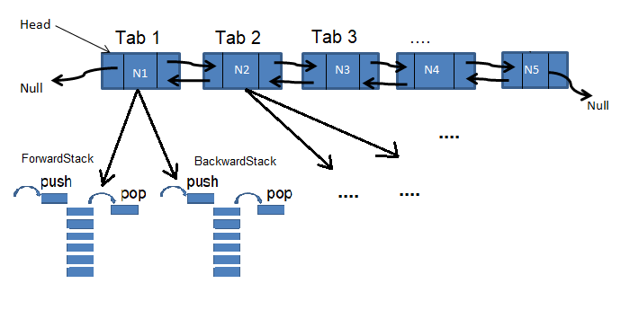
To do this, we will be using a Doubly Linked list and Stacks. Each node of a DLL represents a Tab that has been opened, and the structure of each node will be in such a way that it will be pointing to 2 stacks, the ForwardStack and the BackwardStack. The purpose of the ForwardStack is to maintain the sites/URLs that were accessed after the current site/URL in order. Similarly, the BackwardStack holds all the sites/URLs that were accessed before the current site/URL in order. The most recent tab (node) comes to the front of the DLL, and the second node is the one that was used before this Tab.

Slide 5
OPERATIONS-
Making a new Tab – adding a node to the front of DLL.
Removing a Tab – bringing node to front and setting the second node as the current Tab and removing the front node from DLL.
Switching Tab – bringing the other tab to the front of DLL.
Navigating Backward – the current site is pushed to the ForwardStack, and the top of the BackwardStack becomes the current site.
Navigating Forward – the current site is pushed to the BackwardStack, and the top of the ForwardStack becomes the current site.
Opening new URL/Site - the current site is pushed to the BackwardStack, and the new URL/Site will be set as the current site and the ForwardStack is popped till it becomes empty.

Slide 6
THANK YOU

